Slide 1
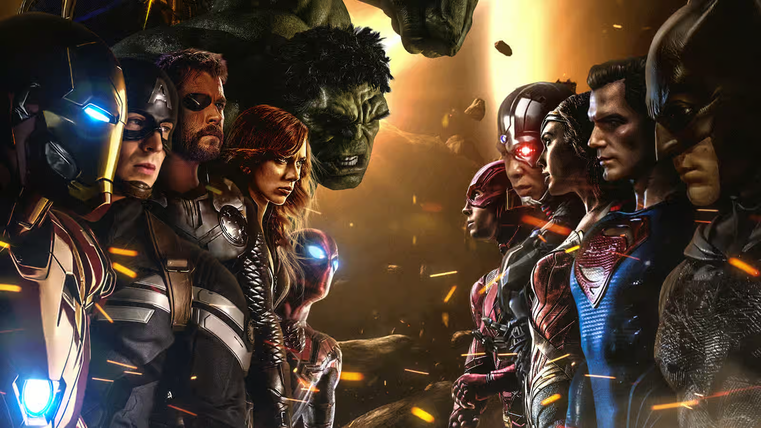
Superheroes Insights
Understanding the World of Superheroes

Slide 2
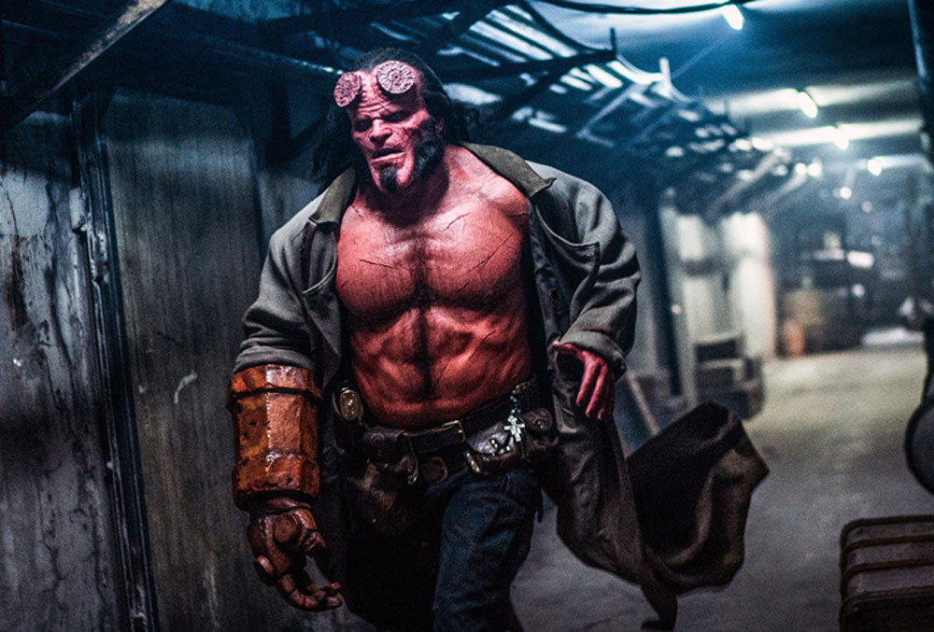
Most Powerful Superheroes

Slide 3
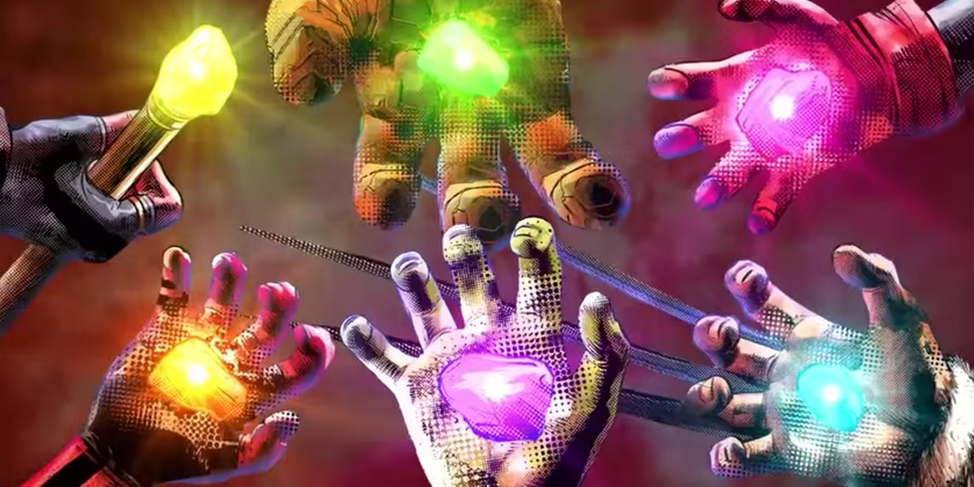
Top 5 Superpowers

Slide 4
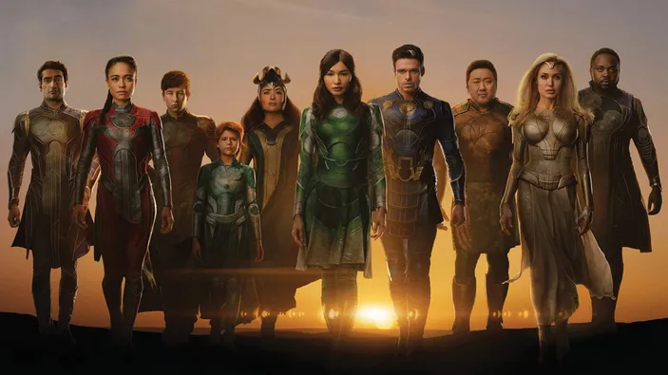
Race with Most Immortal Superheroes

Slide 5
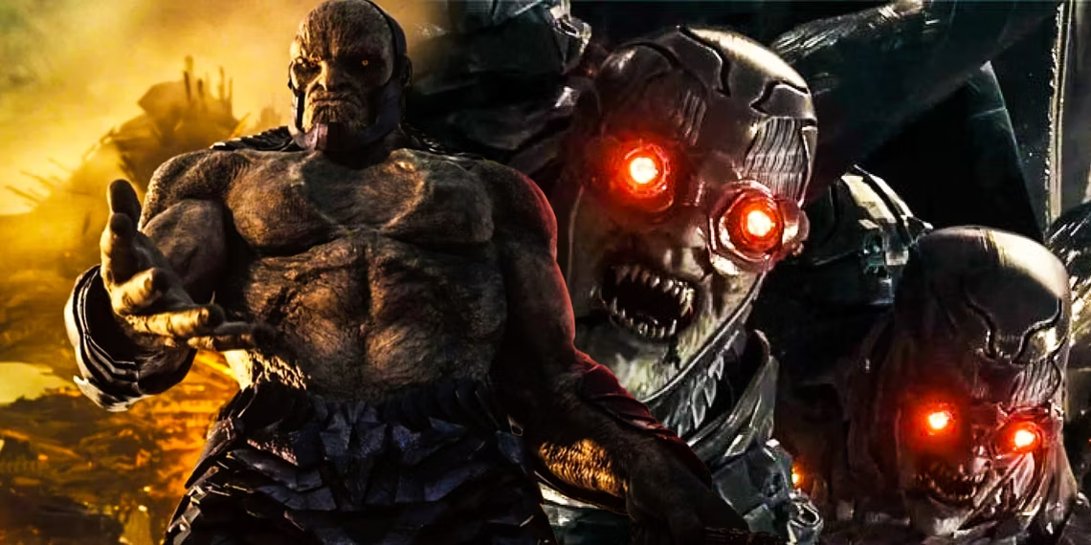

Creator with Most 'Parademon' Superheroes
This Photo by Unknown Author is licensed under CC BY-SA

Slide 6
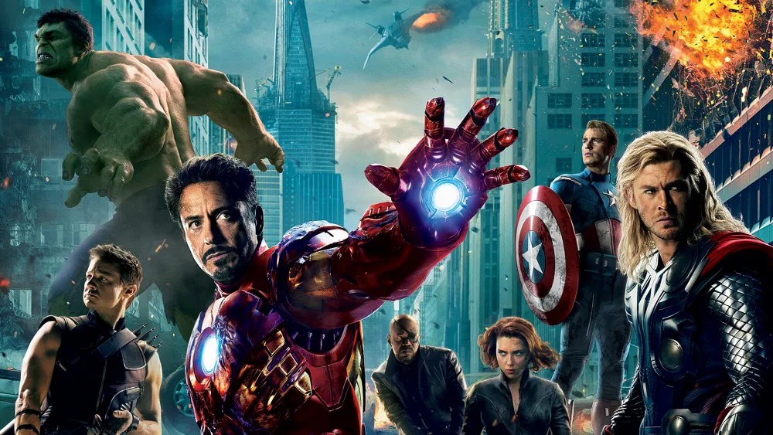
Comic Creator with Most Superhero Teams

Slide 7
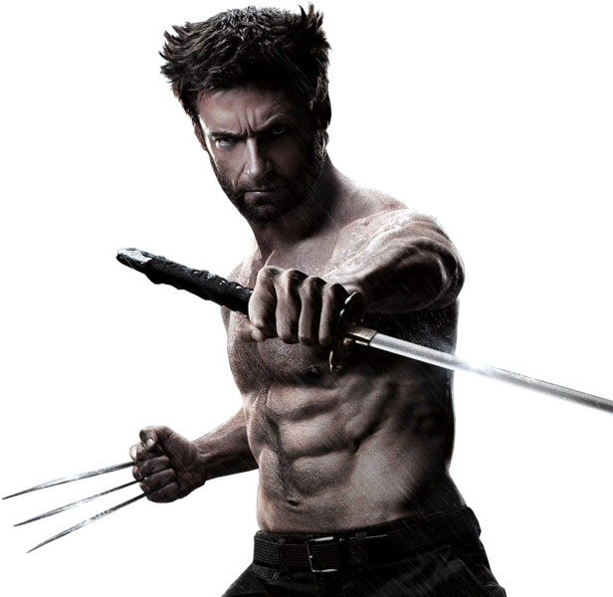
Superhero who is part of most Teams

Slide 8


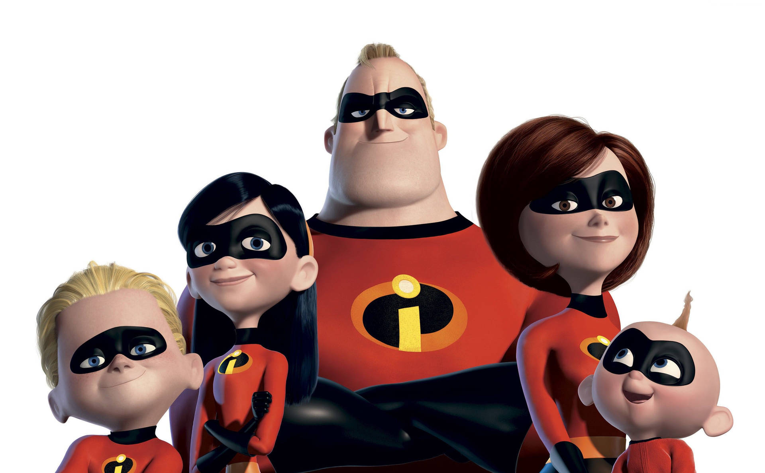
Crossovers between Creators and Teams

Slide 9
Super Signs: Clues to Deciphering a Hero's Alignment
Stealth
Agility
Marksmanship
Flight
Reflexes
Invulnerability
Regeneration
Super Strength
Strength Score
Durability Score

Slide 10
Superheroes with a Negative Past
P.I.X.E.L
Echo Zane
Strong Guy
Martinex
Spyke

Slide 11
Superheroes with Most Relatives

Slide 12
Popular Superheroes to Recommend

Slide 13
Thank You

